Slide 1
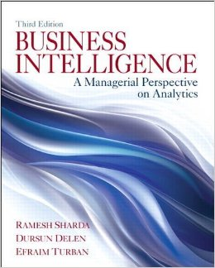
Business Intelligence: A Managerial Perspective on Analytics (3rd Edition)
Chapter 1:
An Overview of Business Intelligence, Analytics, and Decision Support

Slide 2
Changing Business Environment & Computerized Decision Support
Companies are moving aggressively to computerized support of their operations ⇨ Business Intelligence
Business Pressures–Responses–Support Model
Business pressures result of today's competitive business climate
Responses to counter the pressures
Support to better facilitate the process

Slide 3
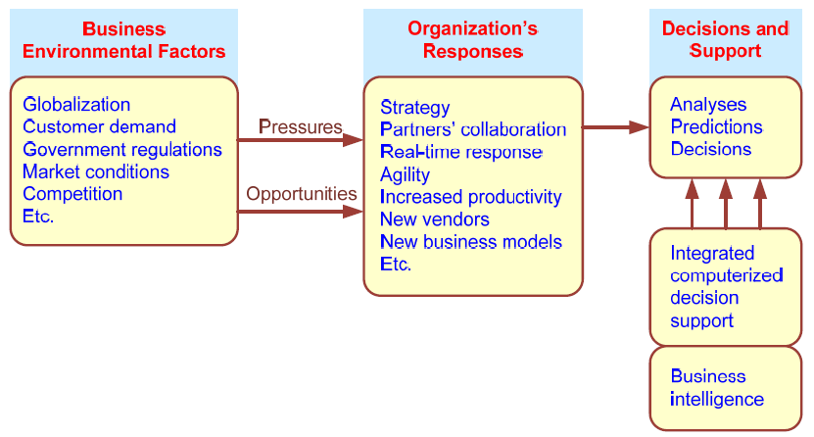
Business Pressures–Responses–Support Model

Slide 4
The Business Environment
The environment in which organizations operate today is becoming more and more complex, creating
opportunities, and
problems.
Example: globalization.
Business environment factors:
markets, consumer demands, technology, and societal…

Slide 5
Business Environment Factors
FACTOR DESCRIPTION
Markets Strong competition
Expanding global markets
Blooming electronic markets on the Internet
Innovative marketing methods
Opportunities for outsourcing with IT support
Need for real-time, on-demand transactions
Consumer Desire for customization
demand Desire for quality, diversity of products, and speed of delivery
Customers getting powerful and less loyal
Technology More innovations, new products, and new services
Increasing obsolescence rate
Increasing information overload
Social networking, Web 2.0 and beyond
Societal Growing government regulations and deregulation
Workforce more diversified, older, and composed of more women Increasing social responsibility of companies
Greater emphasis on sustainability

Slide 6
Organizational Responses
Be Reactive, Anticipative, Adaptive, and Proactive
Managers may take actions, such as
Employ strategic planning.
Use new and innovative business models.
Restructure business processes.
Participate in business alliances.
Improve corporate information systems.

Slide 7
Closing the Strategy Gap
One of the major objectives of computerized decision support is to facilitate closing the gap between the current performance of an organization and its desired performance, as expressed in its mission, objectives, and goals, and the strategy to achieve them.

Slide 8
A Framework for Business Intelligence (BI)
BI is an evolution of decision support concepts over time
Then: Executive Information System
Now: Everybody’s Information System (BI)
BI systems are enhanced with additional visualizations, alerts, and performance measurement capabilities
The term BI emerged from industry

Slide 9
Definition of BI
BI is an umbrella term that combines architectures, tools, databases, analytical tools, applications, and methodologies
BI is a content-free expression, so it means different things to different people
BI's major objective is to enable easy access to data (and models) to provide business managers with the ability to conduct analysis
BI helps transform data, to information (and knowledge), to decisions, and finally to action

Slide 10
A Brief History of BI
The term BI was coined by the Gartner Group in the mid-1990s
However, the concept is much older
1970s - MIS reporting - static/periodic reports
1980s - Executive Information Systems (EIS)
1990s - OLAP, dynamic, multidimensional, ad-hoc reporting -> coining of the term “BI”
2010s - Data/Text/Web Mining; Web-based Portals, Dashboards, Big Data, Social Media, and Visual Analytics
2020s - yet to be seen

Slide 11
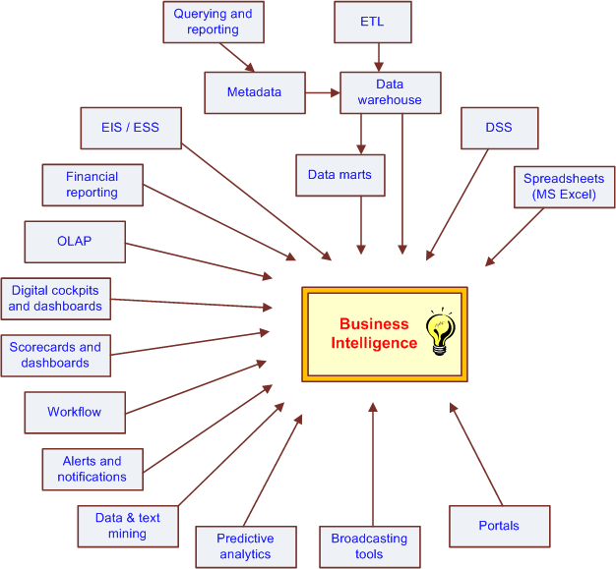
The Evolution of BI Capabilities

Slide 12
The Architecture of BI
A BI system has four major components
a data warehouse, with its source data
business analytics, a collection of tools for manipulating, mining, and analyzing the data in the data warehouse
business performance management (BPM) for monitoring and analyzing performance
a user interface (e.g., dashboard)

Slide 13
A High-Level Architecture of BI

Slide 14
Components in a BI Architecture
The data warehouse is the cornerstone of any medium-to-large BI system.
Originally, the data warehouse included only historical data that was organized and summarized, so end users could easily view or manipulate it.
Today, some data warehouses include access to current data as well, so they can provide real-time decision support (for details see Chapter 2)
Business analytics are the tools that help the user transform data into knowledge (e.g., queries, data/text mining tools, etc.)

Slide 15
Components in a BI Architecture
Business Performance Management (BPM), which is also referred to as corporate performance management (CPM), is an emerging portfolio of applications within the BI framework that provides enterprises tools they need to better manage their operations (for details see Chapter 3)
User Interface (i.e., dashboards) provide a comprehensive graphical/pictorial view of corporate performance measures, trends, and exceptions.

Slide 16
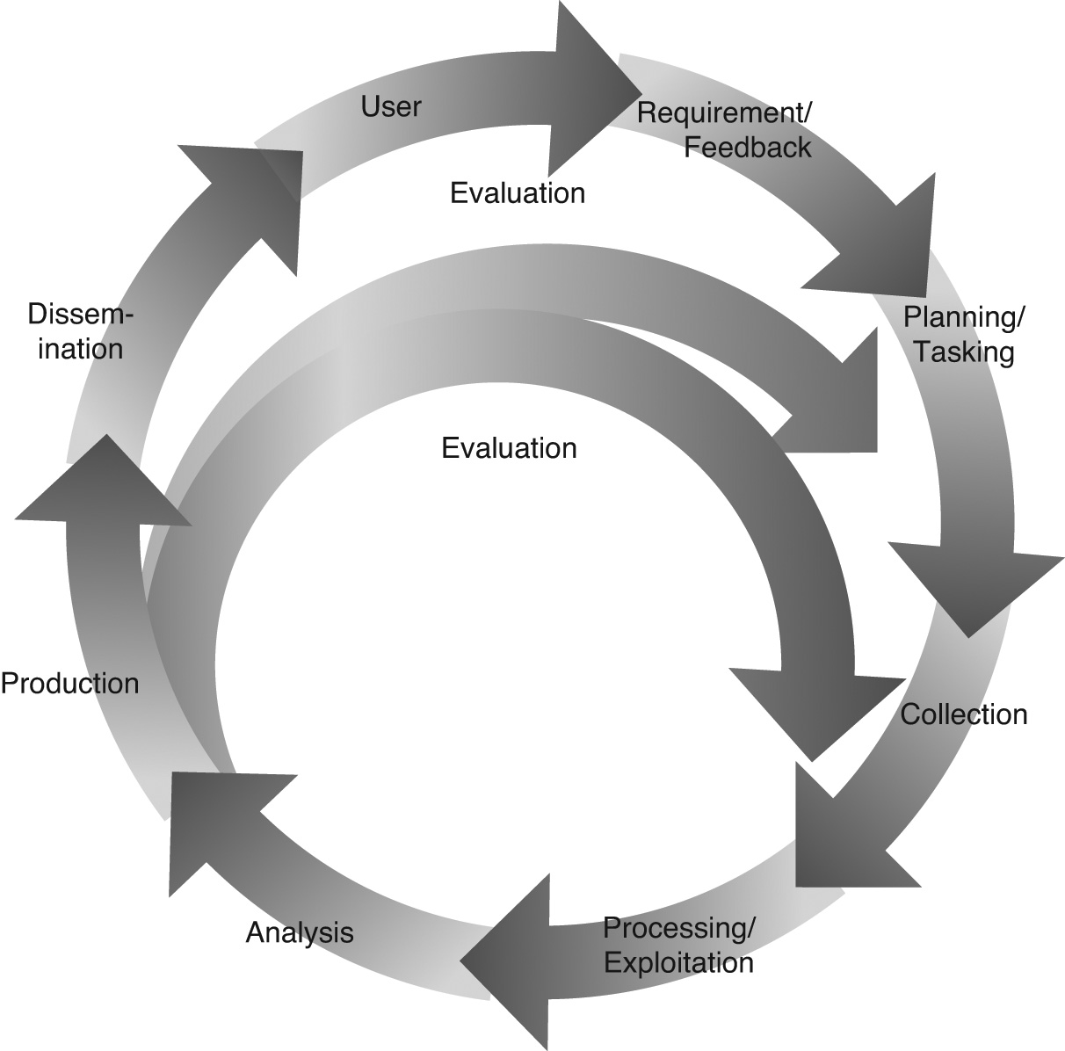
Intelligence Creation, Use, and BI Governance
Data warehouse and BI initiatives typically follow a process similar to that used in military intelligence initiatives.
Intelligence and Espionage

Slide 17
Intelligence and Espionage
Stealing corporate secrets
Intelligence vs. Espionage
Intelligence
The way that the modern companies ethically and legally organize themselves to glean as much as they can from their customers, their business environment, their stakeholders, their business processes, their competitors, and other such sources of potentially valuable information
Problem – too much data, very little value
Use of data/text/Web mining (see Chapters 4, 5)

Slide 18
Transaction Processing Versus Analytic Processing
Transaction processing systems (OLTP) are constantly involved in handling updates (add/edit/delete) to what we might call operational databases
ATM withdrawal transaction, sales order entry via an ecommerce site – updates DBs
OLTP – handles routine on-going business
ERP, SCM, CRM systems generate and store data in OLTP systems
The main goal is to have high efficiency

Slide 19
Transaction Processing Versus Analytic Processing
Online analytic processing (OLAP) systems are involved in extracting information from data stored by OLTP systems
Routine sales reports by product, by region, by sales person, by …
Often built on top of a data warehouse where the data is not transactional
Main goal is the effectiveness (and then, efficiency) – provide correct information in a timely manner

Slide 20
Successful BI Implementation
Implementing and deploying a BI initiative is a lengthy, expensive, and risky endeavor
Success of a BI system is measured by its widespread usage for better decision making
The typical BI user community includes
Not just the top executives (as was for EIS)
All levels of the management hierarchy
Provide what is needed to whom needs it
A successful BI system must be of benefit to the enterprise as a whole…

Slide 21
BI - Alignment with Business Strategy
To be successful, BI must be aligned with the company’s business strategy
BI cannot/should not be a technical exercise for the information systems department
BI changes the way a company conducts business by
improving business processes, and
transforming decision making to a more data/fact/information driven activity
BI should help execute the business strategy and not be an impediment for it

Slide 22
Issues for Successful BI
Developing vs. Acquiring BI systems
Justifying via cost-benefit analysis
It is easier to quantify costs
Harder to quantify benefits
Security and Protection of Privacy
Integration of Systems and Applications

Slide 23
Real-Time, On-Demand BI Is Attainable
The demand for “real-time” BI is growing
Is “real-time” BI attainable?
Technology is getting there…
Automated, faster data collection (RFID, sensors,… )
Database and other software technologies
Telecommunication infrastructure is improving
Computational power is increasing while the cost for these technologies is decreasing

Slide 24
BI Implementation Considerations
Developing or acquiring BI systems
BI shell?
In-house versus outside consultants
Justification and cost-benefit analysis
Security and protection of privacy
Integration of systems and applications

Slide 25
Analytics Overview
Types of Analytics
Descriptive Analytics
Predictive Analytics
Prescriptive Analytics

Slide 26
Analytics Overview

